Slide 1
Practice #1
Create Performance Task

Slide 2
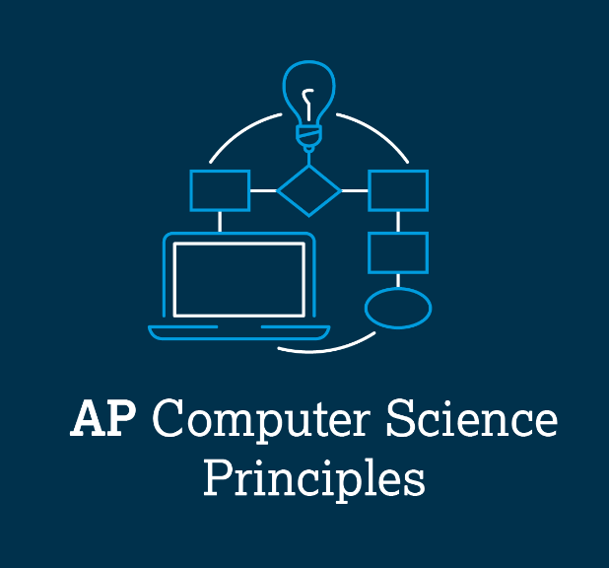
AP CSP Create Performance Task
Part of the AP Exam is to create a program that meets specific requirements:
Creates a list
Uses a list in a meaningful way
Has a function with a parameter
  Parameter affects function execution
Function has:
  If statement
  Loop

Slide 3
AP CSP Create Performance Task
Things to know about the Create PT:
You can work with a partner
Your classmates can help you
Your teacher cannot help you
You cannot use an assigned program for your project, but it can be similar
You will be given 9 hours of class time to work on the project

Slide 4
AP CSP Create Performance Task
The Create PT is like a remix project:
Start small and add components.
Start with what you know.
Don’t try something new that you don’t know how to do.
This isn’t a time to learn something new, but to show what you know how to do.

Slide 5
AP CSP Create Performance Task
The Create PT is like a remix project:
During a remix, you looked at completed programs and reviewed what you learned.
You either added to or created a program similar to your completed programs.
You can do the same thing for the Create PT.
Let’s look at a program from a mission and remix it to meet the requirements of the Create PT.

Slide 6
Practice #1
In CodeSpace, go to the Sandbox.
Open the project: Pixels1_matrix
Go to File Save As… and rename the file PT_Practice1
Review the code.
What PT requirements does it meet?
What PT requirements does it lack?

Slide 7
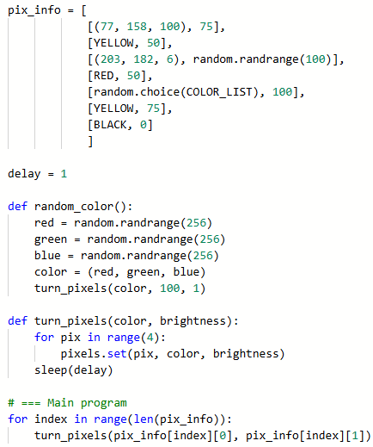


Practice #1
PT Requirements
Creates a list
Uses a list in a meaningful way
Has a function with a parameter
  Parameter affect function execution
Function has:
  If statement
  Loop

Slide 8
Practice #1
This project meets most of the requirements.
By adding just a few lines of code, the program can meet all the requirements.
Can you think something to add to the program to meet the requirements?
Go to the Activity Guide and write down some possible program modifications.

Slide 9
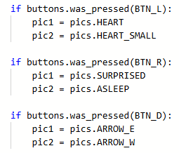
Practice #1
There are many things you can do!
One way is to add a second list.
Use a button to select which list is used.
This is similar to the Heart2_parameters project.
Open the project and review the code for each button press.
The buttons determined which images were displayed.

Slide 10
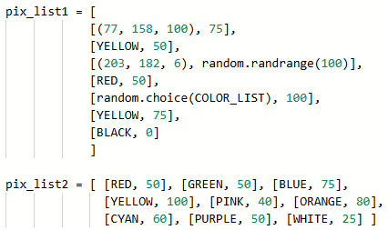
Practice #1
Return to PT_Practice1
Add a second list of pixel information.
It can be more simple than the first.

Slide 11
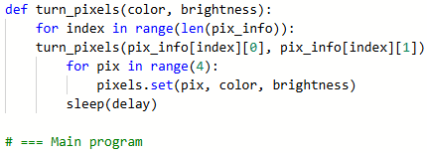
Practice #1
Modify the function with parameters
First, you need to move the code from the main program into the function.
The for loop that is already there will be nested inside the other for loop.

Slide 12
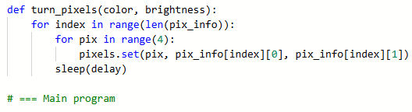
Practice #1
Modify the function with parameters
Replace the arguments in pixels.set() with the matrix.

Slide 13

Practice #1
Now change the parameters:
You only need to know which list to traverse.
The parameter will be choice.
Use choice in an if statement to select the list.
  The if statement is at the beginning of the function.

Slide 14
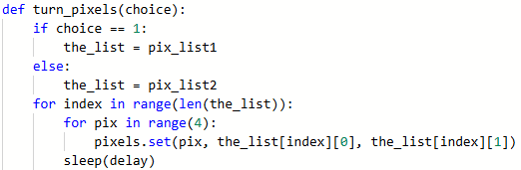
Practice #1
Use the selected list.
Throughout the function, change pix_info to the_list

Slide 15
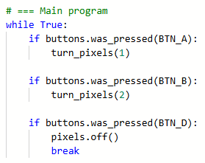

Practice #1
Last step: use the buttons to call the function.
In the main program, write code for each button press.
Use a literal value for the argument.
You can use a button as a kill switch.

Slide 16
Practice #1
Look at your code again. Does it meet all requirements?
Creates a list
Uses a list in a meaningful way
Has a function with a parameter
  Parameter affect function execution
Function has:
  If statement
  Loop

Slide 17
Practice #1
Now that you have seen an example of modifying the Pixel1 program, can you think of any other ways to remix the project for the Create PT?
Go to the Activity Guide and write down any more ideas you have for modifications.

Slide 18
Practice #1
Final considerations.
Your program needs to have input and output.
  Can you explain the input and output of this program?
Your program needs to have a purpose and intended users.
  Can you explain the purpose of the program?
  Can you explain who the intended users are?
This program doesn’t really do much, other than display a light show. If you create a program similar to this for the Create PT, you will need to have a clear purpose and intended user.

